Slide 1

Superscalar Processor Simulator
Finn Wilkinson – FW17231

Slide 2
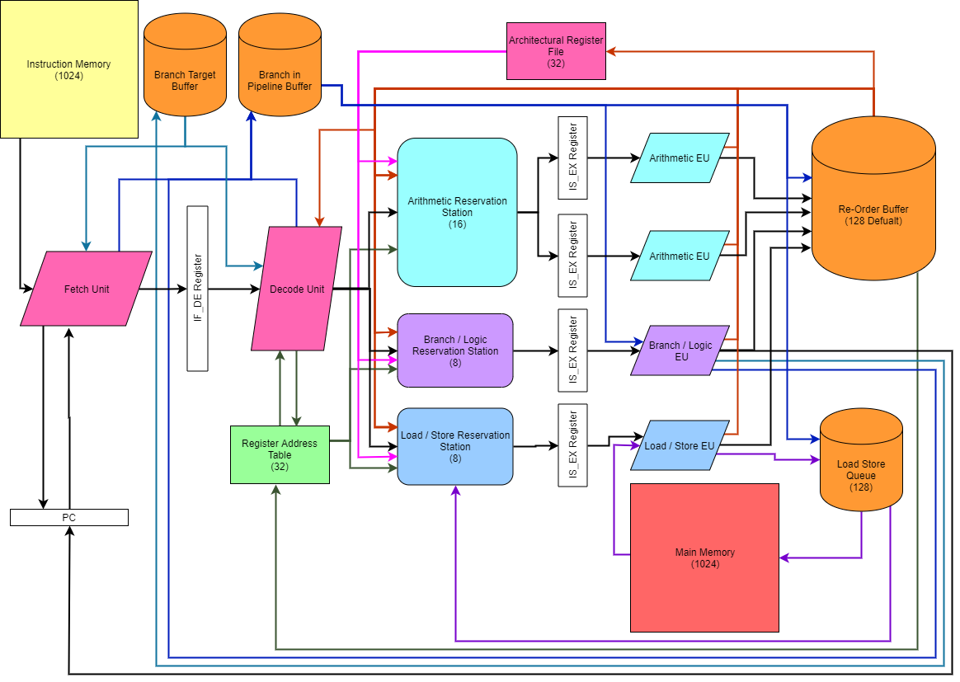
Architecture Design
Fetch
Decode
Issue
Execute
Write Back

Slide 3
Processor Features
General
32 General Purpose Registers
5 stage pipeline
Fetch, Decode, Issue, Execute, Write-Back
Multi-Cycle instructions
Multiply - 2 cycles
Divide - 16 cycles
Out-of-Order execution
Register re-naming
Utilised Register Address Table
Prevents Name Dependencies, WAW & WAR hazards
Scalar, 2-way superscalar, or 4-way superscalar
Pipeline Features
2 Arithmetic EUs
1 Branch and Logic EU
1 Load and Store EU
Grouped Reservation Stations
16 spaces for Arithmetic
8 spaces for Branch and Logic
8 spaces for Load and Store
Result forwarding
Branch Prediction
Can select from
Fixed – Always predicts branch is taken
Static – If jumping backwards predict taken
1-bit Dynamic – Make prediction on previous result
2-bit Dynamic – Make prediction on previous 2 results
BTB keeps history of all branches seen before
Also keeps track of previous results if dynamic prediction selected
Branch in Pipeline Buffer
Tracks un-executed branches in the pipeline
Ensures nothing is committed to ARF or MEM out of program order
Allows for easy misprediction recovery and flushing
Memory and Write-Back
Variable size Re-Order Buffer (default is 128)
Ensures program order write back to ARF, preventing RAW hazards
Load-Store Queue of size 128
Ensures Loads and Stores happen in program order
Loads wait for all previous store addresses to be known before being issued to prevent RAW hazards

Slide 4
Benchmark Programs
All Scripts are looped in assembly 100 times to gain a more accurate IPC
Factorial | Recursively calculates the factorial of 12
Matrix Multiplication | Multiplies together a (6x4) matrix and a (4x6) matrix using branches to loop round
Unrolled Matrix Multiplication | Multiplies together a (6x4) matrix and a (4x6) matrix with an unrolled loop
Vector Addition | Adds together two vectors of length 10 A[i] = B[i] + c[i]
Quick Sort | Applies the quicksort algorithm to a list of length 30 utilising recursion and an in-memory stack
Game of Life | 20 iterations of Conway’s game of life on a 16x16 grid in-memory with wrap-around boarders

Slide 5
Experiment #1 – Number of Pipelines
Hypothesis
Doubling the number of pipelines will increase the IPC by x2, as well as reducing the number of cycles taken to execute each script by half.
Experiment
Comparing IPC values and total cycles for 1, 2, and 4 pipelines over all benchmark programs. 2-bit Dynamic Branch prediction will be used as well as a 512-bit ROB to achieve as best results as possible for each test.
Results
Stuff
Comments
hh

Slide 6
Experiment #2 – Comparing Branch Predictors
Hypothesis
For each of the benchmark programs, Fixed and Static prediction will achieve similar results. 1-bit and 2-bit Dynamic will also have similar results, whilst outperforming Static and Fixed branch prediction.
Experiment
For a 4 pipeline processor with 512-bit ROB, test each branch prediction type and compare the IPC, correct predictions, and number of pipeline flushes.
Results
Stuff
Comments
hh

Slide 7
Experiment #3 – Size of Re-Order Buffer
Hypothesis
An increased ROB size will increase the IPC and reduce the number of stalls.
Experiment
For a 4-way superscalar processor with 2-bit dynamic branch prediction, the ROB size will be increased from 8 to 512 in logical steps for all benchmark programs.
Results
Stuff
Comments
hh

